Slide 1
Airbnb New User Bookings
Marc Campbell
3/2/16

Slide 2

Notes:
Every day thousands of users book a place to stay with Airbnb. I myself am an avid user of AirBnb, but lets say for example that I wasn’t. I have an upcoming trip to Australia that I’m planning on taking later this year.
From a marketing perspective wouldn’t it be useful if AirBnb could predict where I’m going to stay, and send relevant display ads or content on my web journey.

Slide 3
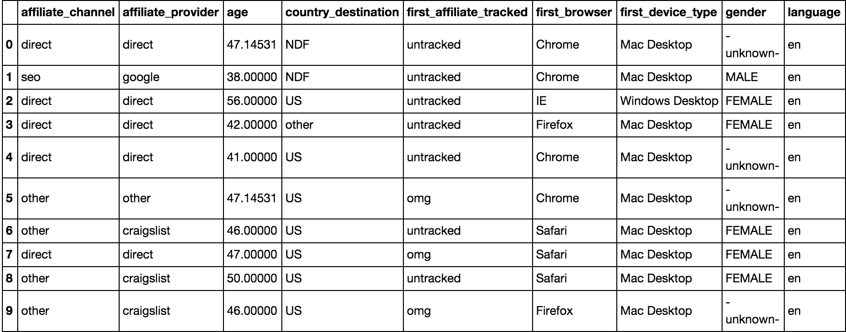
The Data
213451 train users | 62096 test users

Slide 4
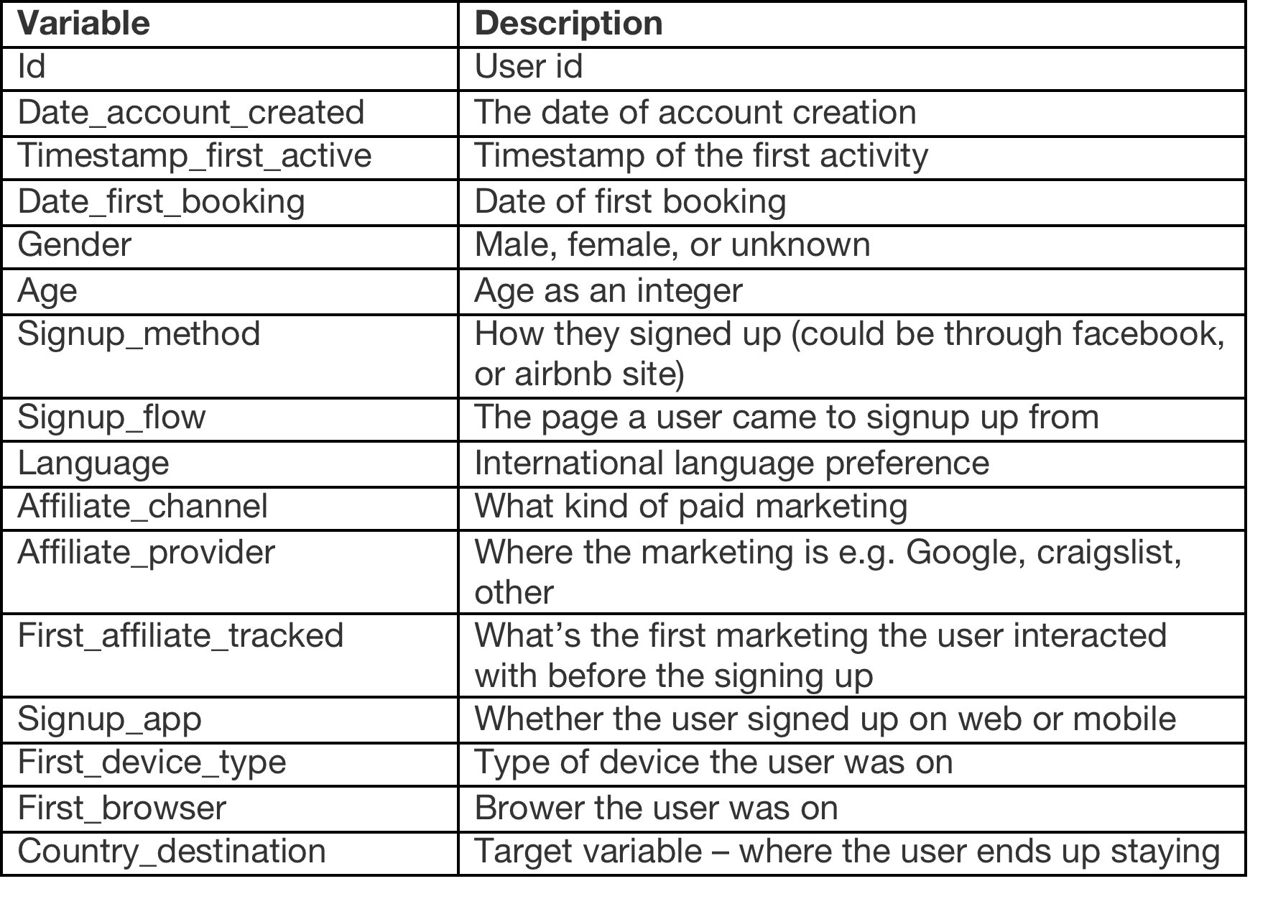
Features

Slide 5



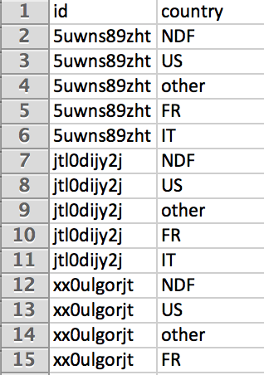







Output
NDF
OTHER

Slide 6
Preprocessing and Feature Engineering

Slide 7
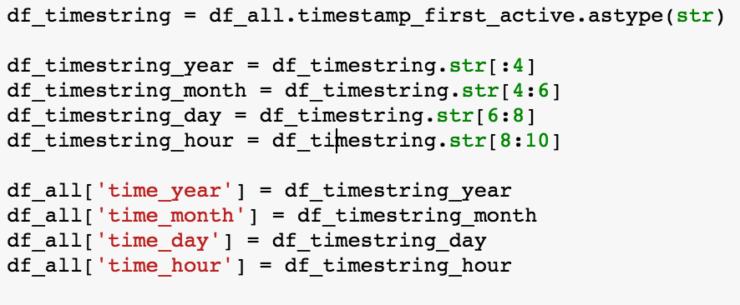
Decoupling Dates

Slide 8
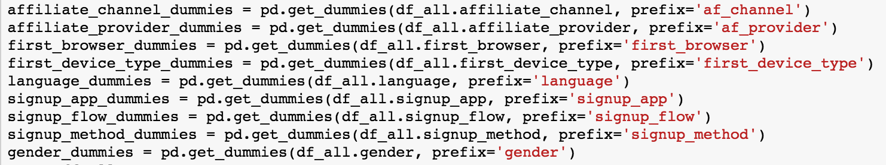
Getting Dummies

Slide 9
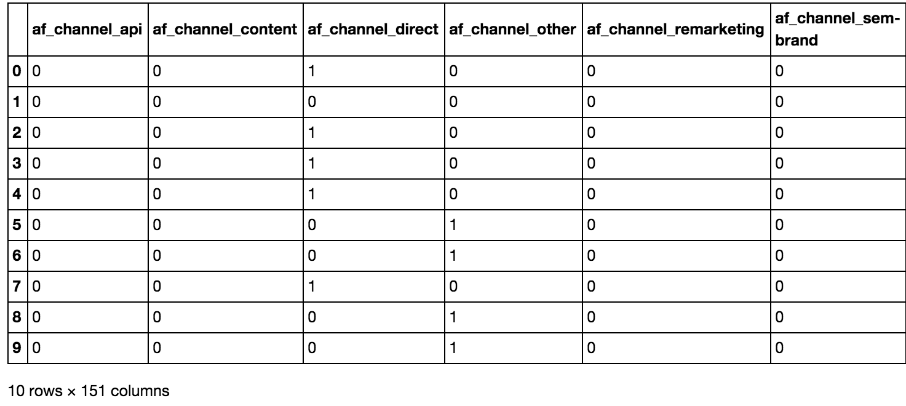
Features

Slide 10
Classification Method
XgBoost
Gradient Boosting Ensemble
Fast
Heavily used by Kagglers because of its versatility
Allows for heterogeneous data (binary or continuous)
Doesn’t require normalization
Automatically detects non-linear feature interactions

Slide 11
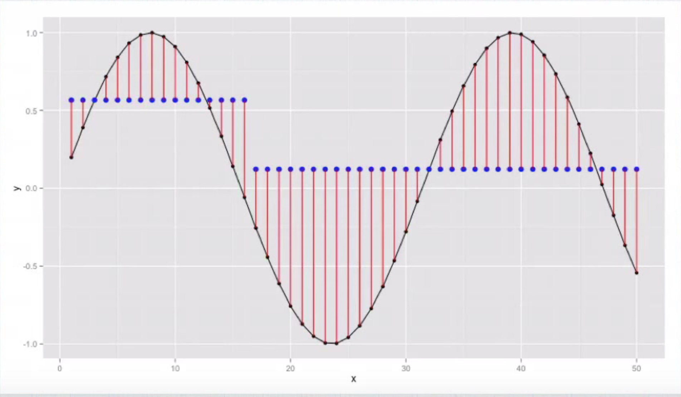
1 Tree

Slide 12
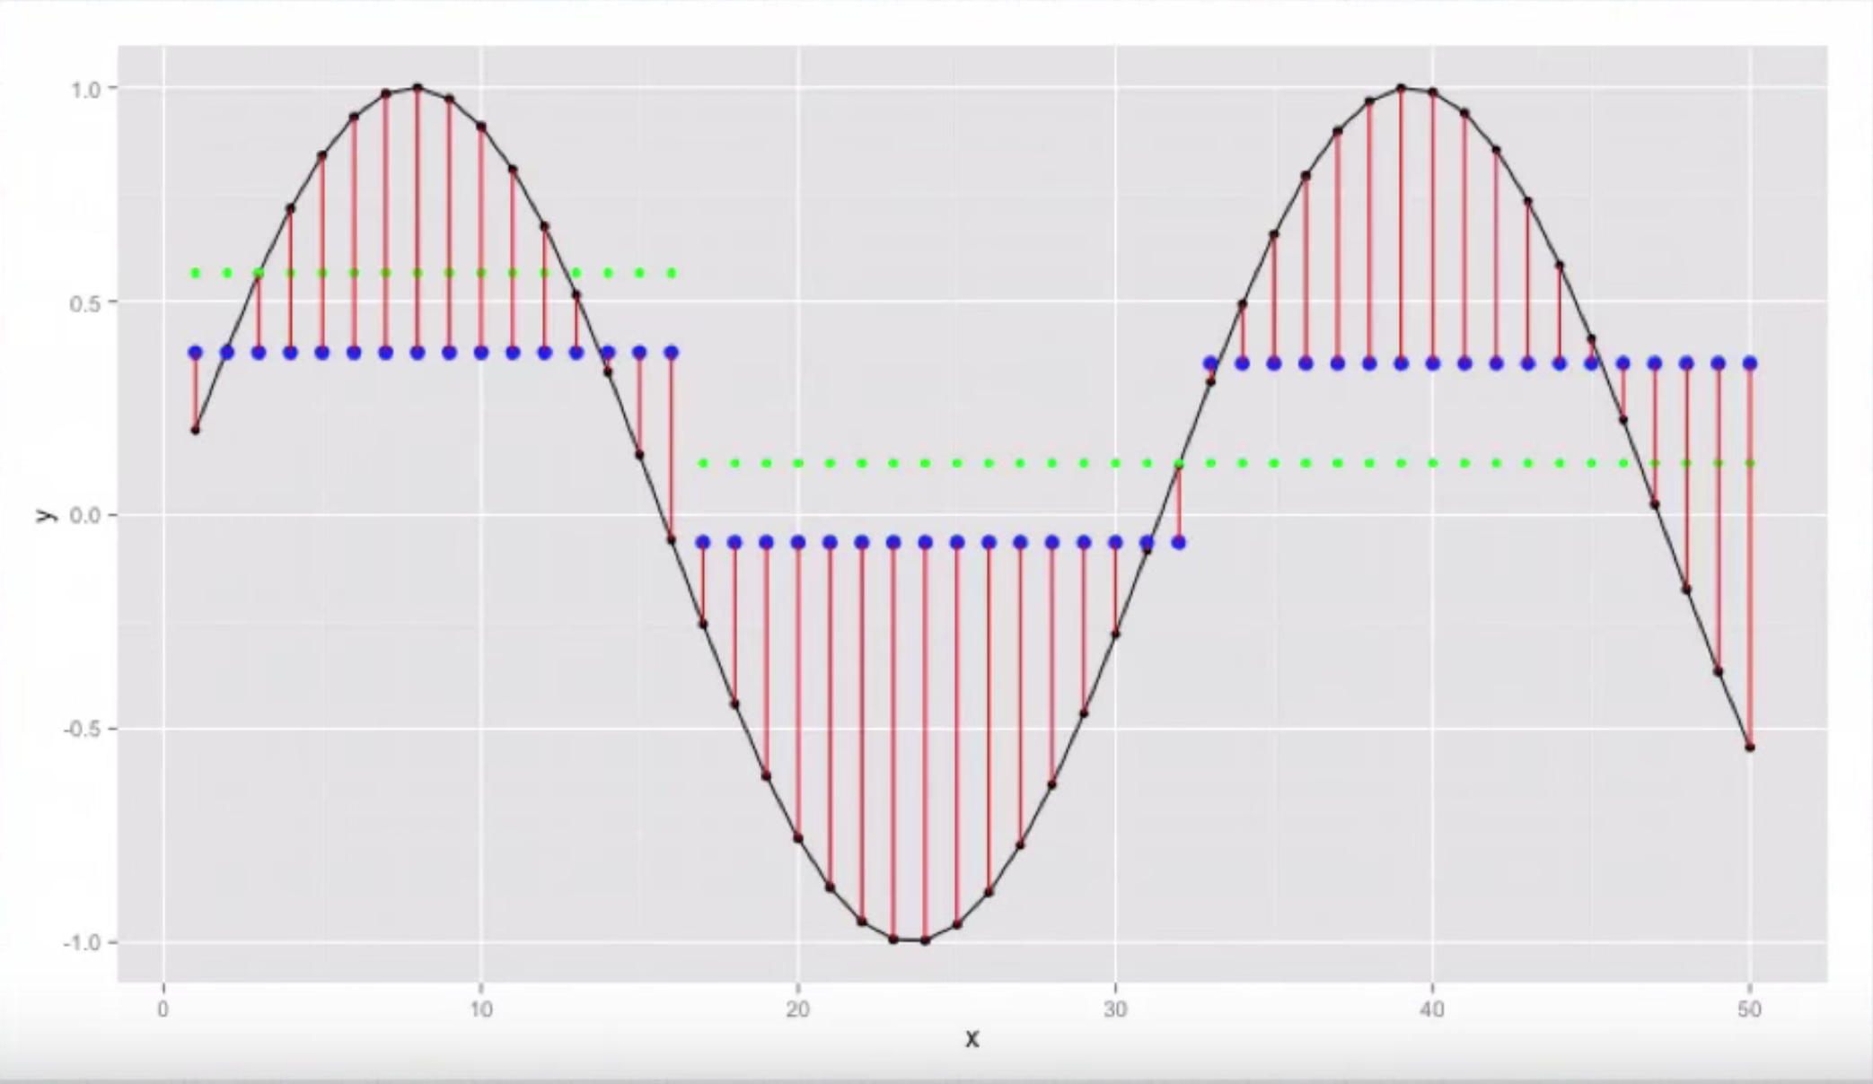
2 Trees

Slide 13
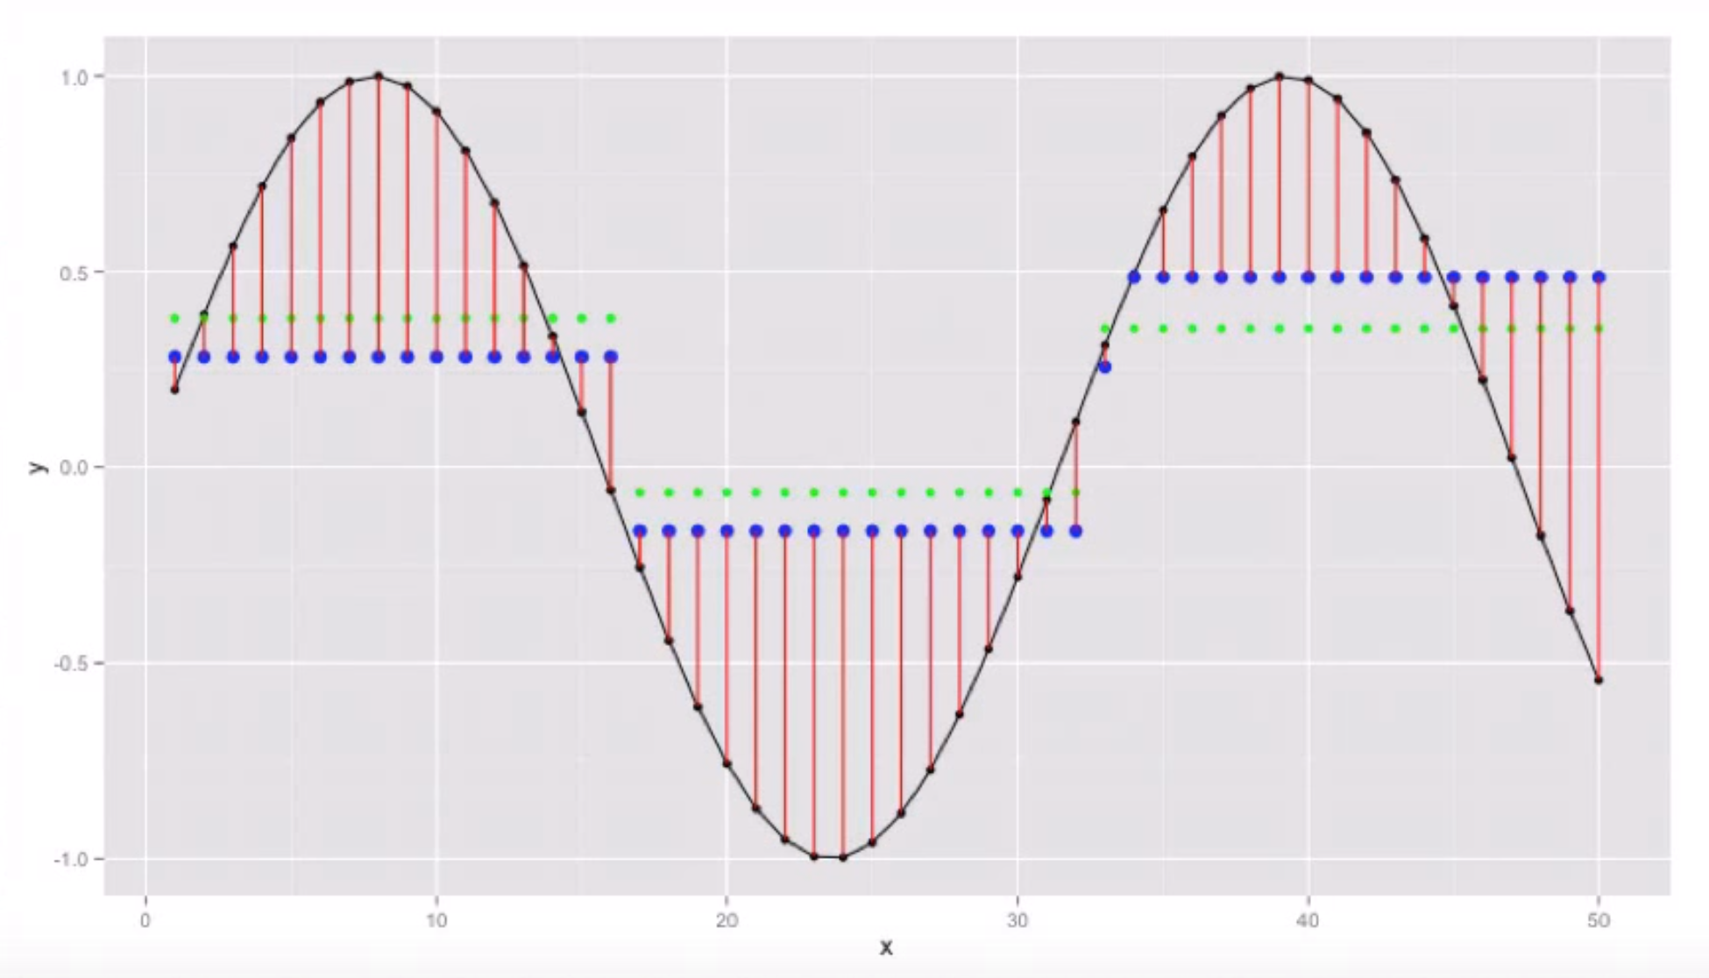
3 trees

Slide 14
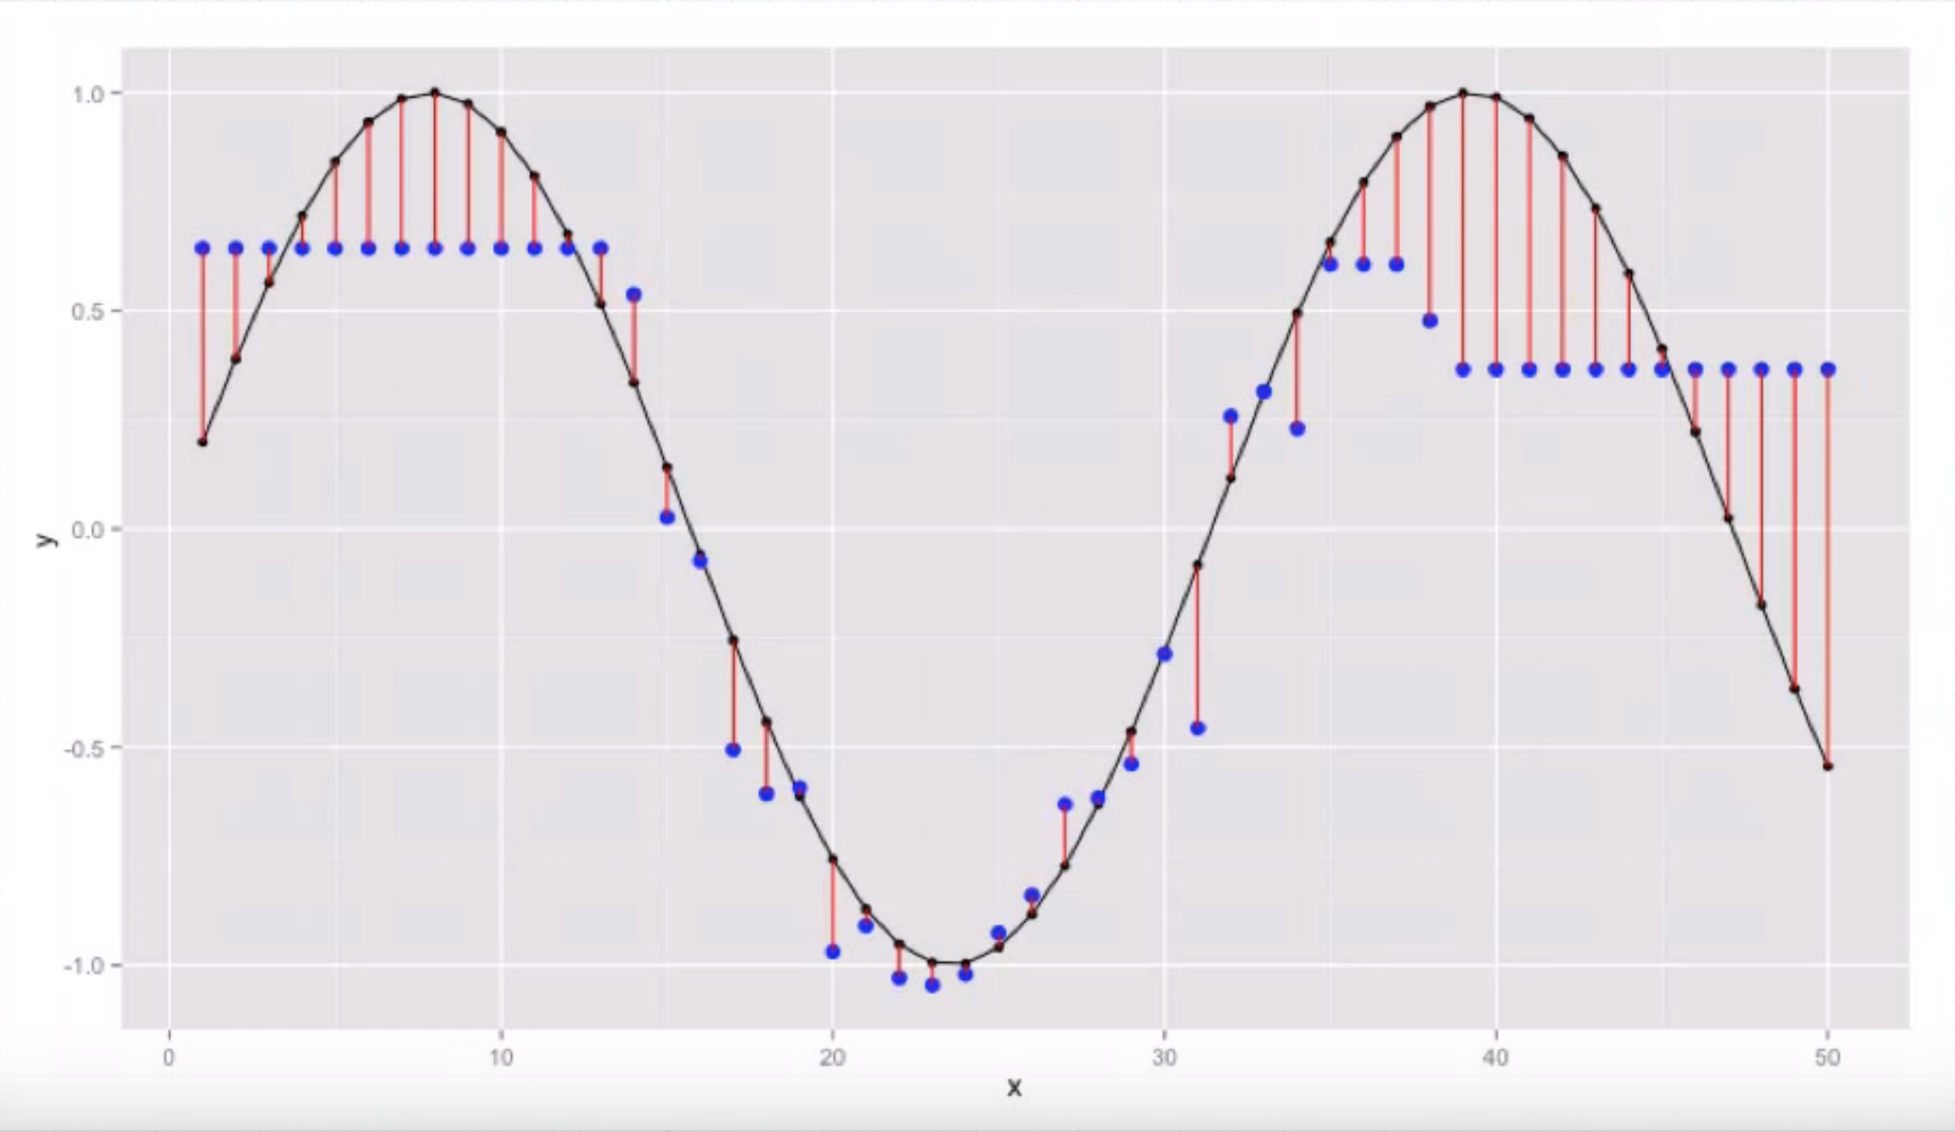
100 trees

Slide 15
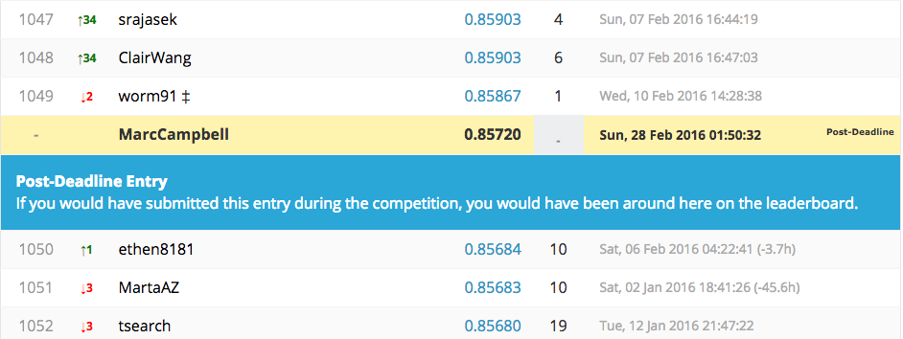
Results: Initial
Features: affiliate_channel_dummies, affiliate_provider_dummies, age, gender_dummies
Model Parameters: default
Notes:
Initial - affiliate_channel_dummies, affiliate_provider_dummies, age, gender_dummies

Slide 16
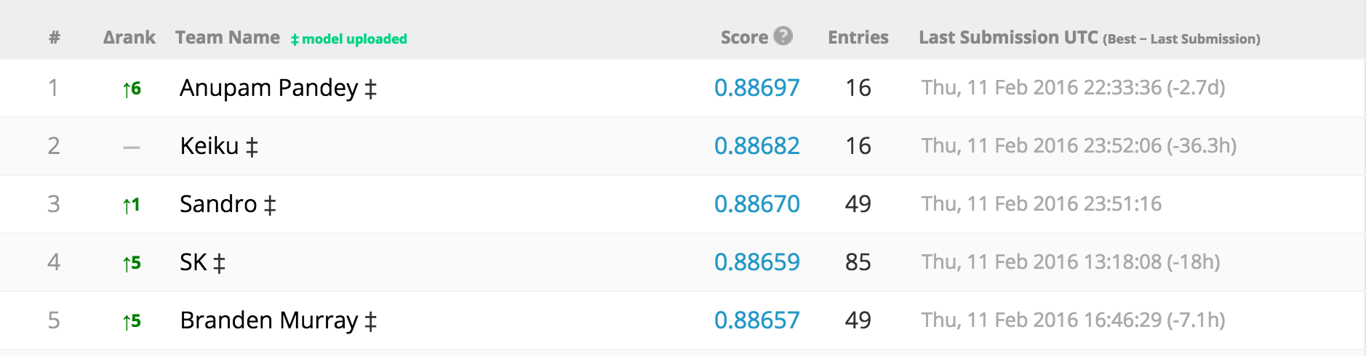
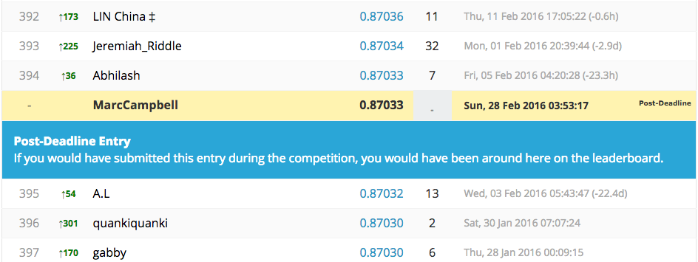
Results: All features, tweaked parameters

Slide 17
Challenges and Next Steps
Understanding Xgboost – bit of a black box
Applying other models
Feature importance, incorporating more features
Projects with messier data
More Kaggle competitions

Slide 18
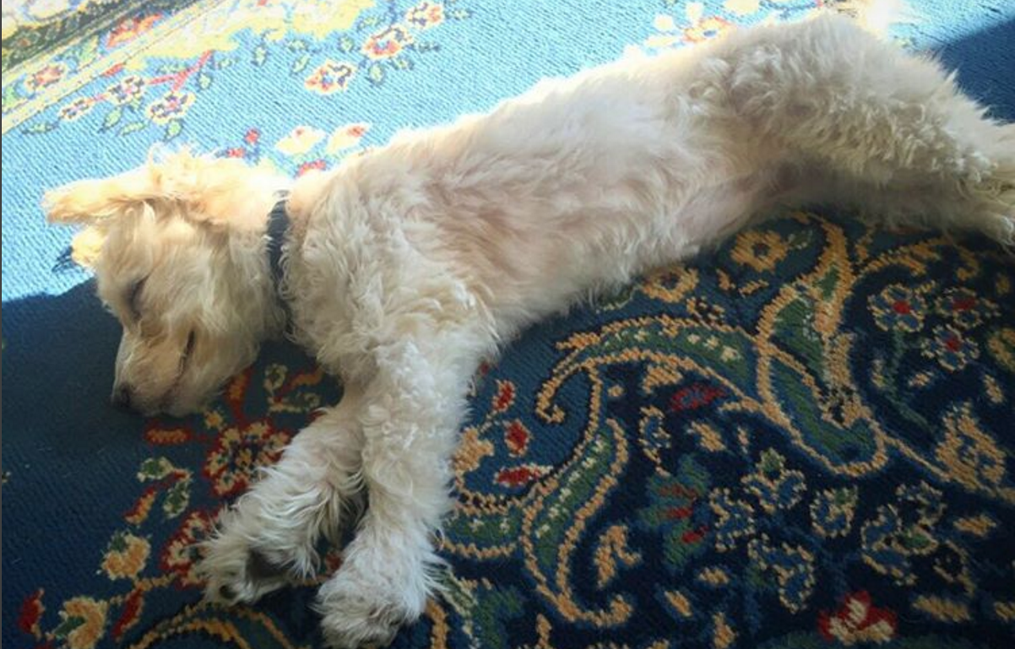
Thanks!

